Slide 1
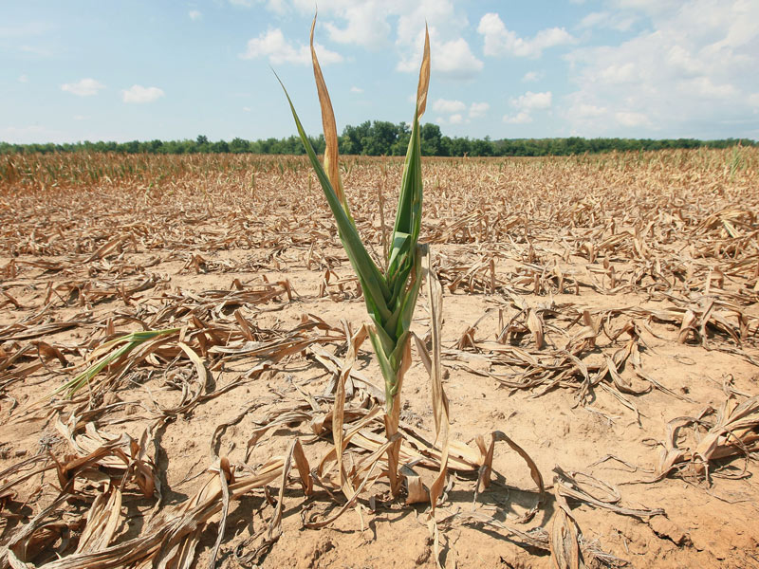
Drought stress in plants
GROUP 17

Slide 2
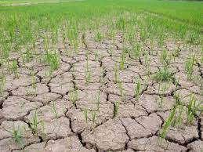
outline
Definition
Importance of water to plants
Key effects of drought on plants
Adaptation of plants to drought stress

Slide 3
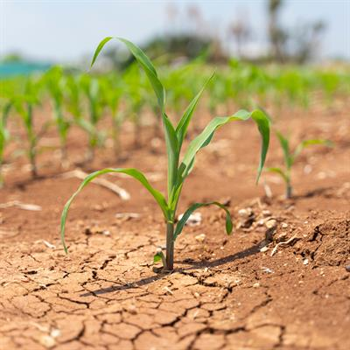
Definition of drought in plant science
Drought refers to a period of abnormally dry weather or a prolonged lack of precipitation that leads to water deficiency in the soil and negatively affects plant growth, development and productivity.

Slide 4
Importance of water to plants
Water is essential for the growth and survival of plants , playing a crucial role in their overall health and function. Here are some key reasons why water is of utmost importance to plants:
Photosynthesis
Nutrient uptake
Turgor pressure

Slide 5
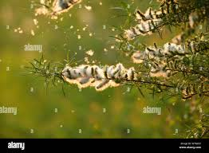
Importance of water to plants cont’d
Transpiration
Temperature regulation
Cell expansion and growth
Reproduction and seed dispersal

Slide 6
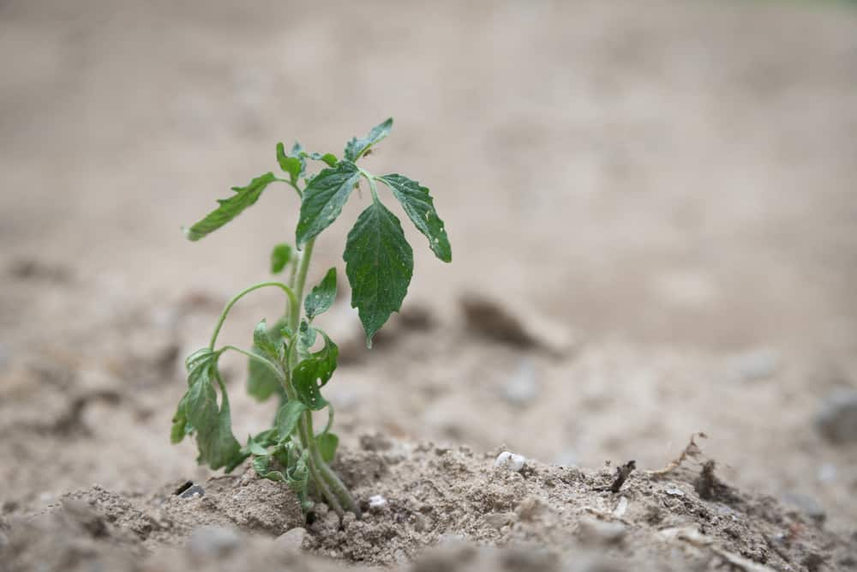
Key effects of drought stress on plants
During a drought, the available water in the soil becomes limited, and plants may struggle to access the necessary water for their metabolic processes and to maintain turgor pressure essential for structural integrity and growth.
Some of the key effects on drought includes:
Reduced photosynthesis
Altered metabolism
Reduced yield

Slide 7
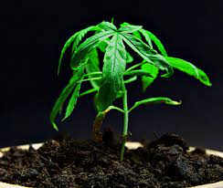
KEY EFFECTS OF DROUGHT STRESS ON PLANTS CONT’D
Stunted growth
Fig. 1 A plant with stunted growth

Slide 8
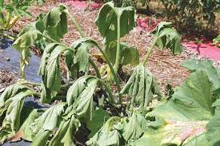
KEY EFFECTS OF DROUGHT STRESS ON PLANTS CONT’D
Wilting
Fig. 2 A wilted plant

Slide 9
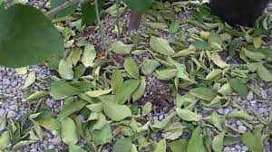
KEY EFFECTS OF DROUGHT STRESS ON PLANTS CONT’D
Premature leaf drop
Fig. 3 Leaf drop

Slide 10

Adaptation of plants to drought stress
Plants may exhibit various physiological, morphological, and biochemical changes as adaptive responses to cope with the drought stress. These adaptations help plants conserve water, reduce water loss and maximize water uptake.

Slide 11
MORPHOLOGICAL ADAPTATIONS
Reduced leaf surface area
Example Cactus plant
Fig. 4 A cactus plant

Slide 12
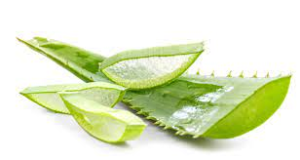
Morphological adaptation CONT’D
Succulence
Example: Aloe vera
Deep root systems
Example: Mesquite tree
Extensive shallow root systems
Example: Prairie grasses
Fig. 5 An aloe vera plant

Slide 13
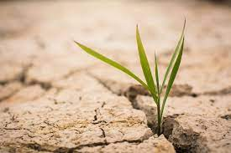
Physiological adaptation
Crassulacean Acid Metabolism (CAM)
Osmotic adjustment

Slide 14
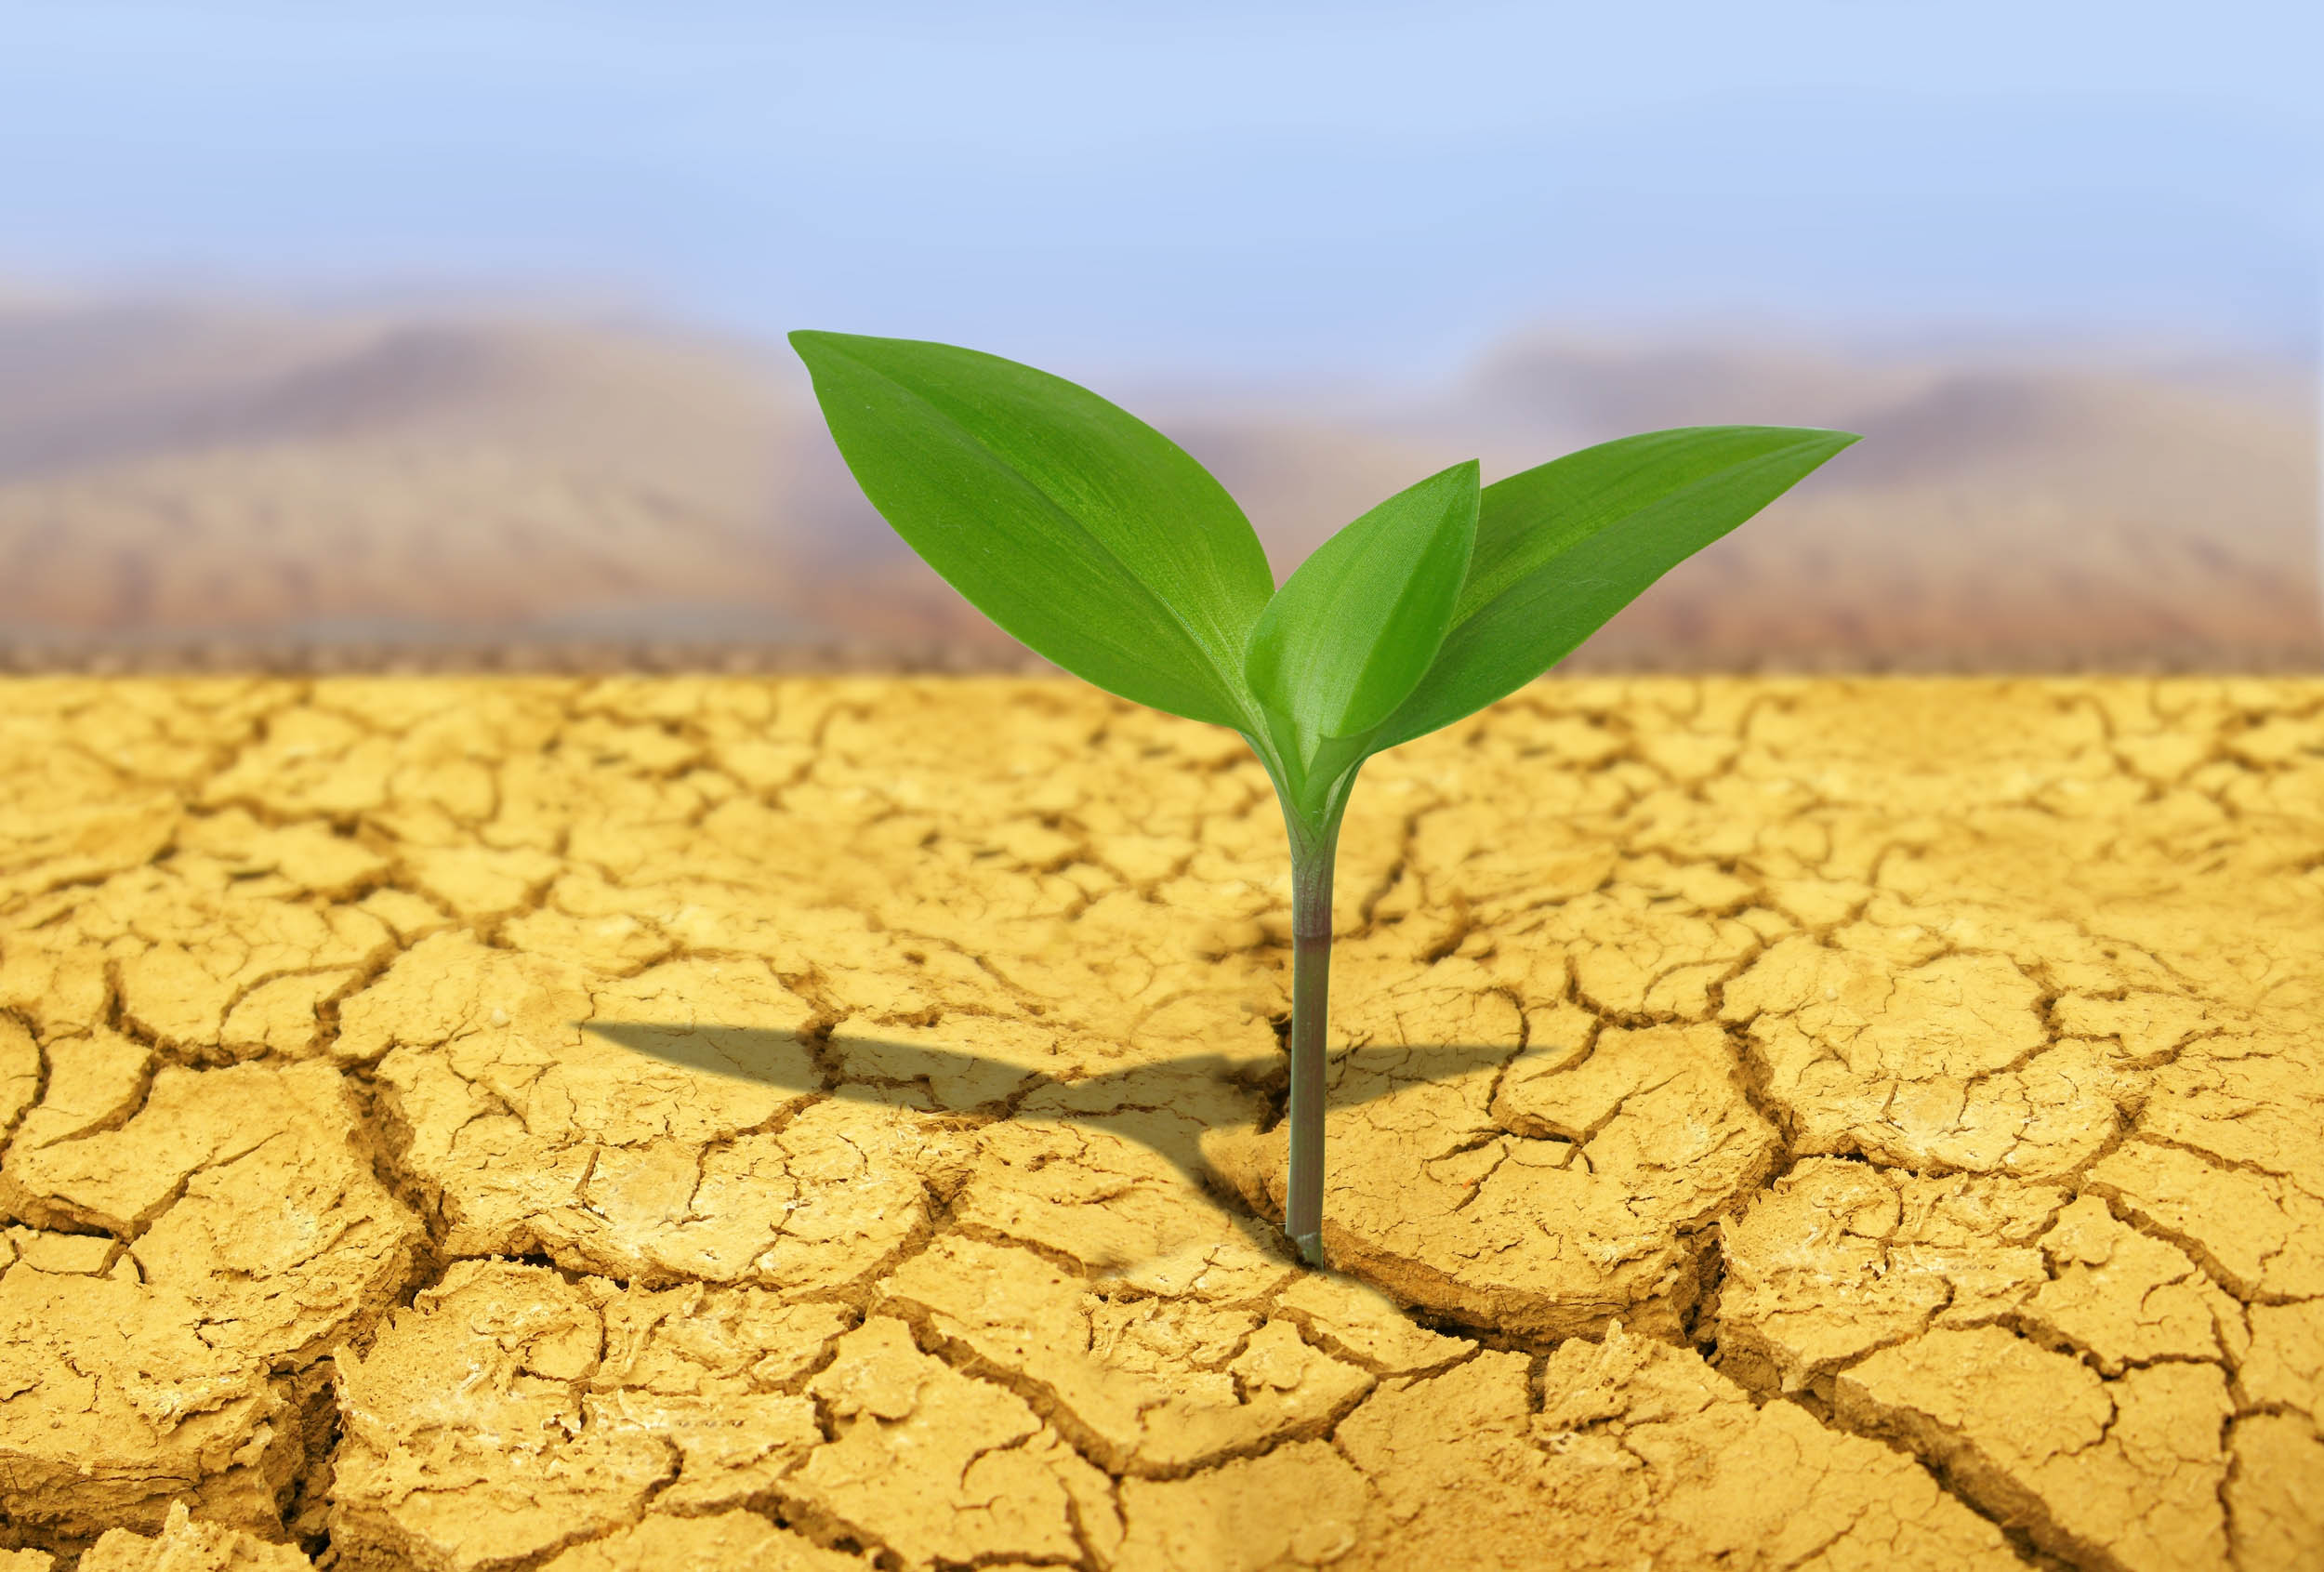
Biochemical adaptations
Antioxidant defense system
Synthesis of Abscisic Acid

Slide 15
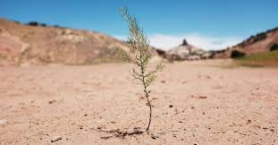
conclusion
Urgent action is needed to address the escalating challenges posed by drought stress on our ecosystems, agriculture and water resources.
Together, we can forge a path towards a more sustainable and resilient future in the face of increasing drought conditions.

Slide 16
references
Abbate PE, Dardanellib JL, Cantareroc MG, Maturanoc M, Melchiorid RJM, Sueroa EE (2004) Climatic and water availability effects on water-use efficiency in wheat. Crop Sci 44:474–483
Abebe T, Guenzi AC, Martin B, Cushman JC (2003) Tolerance of mannitol-accumulating transgenic wheat to water stress and salinity. Plant Physiol 131:1748–1755
Farooq M, Wahid A, Kobayashi N, Fujita D, Basra SMA (2009c) Plant drought stress: effects, mechanisms and management. Agron Sustain Devel 29:185–212
Flexas J, Bota J, Loreto F, Comic G, Sharkey TD (2004) Diffusive and metabolic limitations to photosynthesis under drought and salinity in C3 plants. Plant Biol 6:269–279
Perez-Perez JG, Robles JM, Tovar JC, Botia P (2009) Response to drought and salt stress of lemon ‘Fino 49’ under field conditions: Water relations, osmotic adjustment and gas exchange. Sci Hort 122:83–90

Slide 17


